Slide 1
How to Read/Summarize/Write a Research Paper
CSE 300: Technical Writing & Presentation

Slide 2
Section 3: Seven Suggestions
Writing a CS Paper

Slide 3
Seven simple, actionable suggestions that will make your papers better.
Courtesy: Simon Peyton Jones
Microsoft Research Cambridge

Slide 4


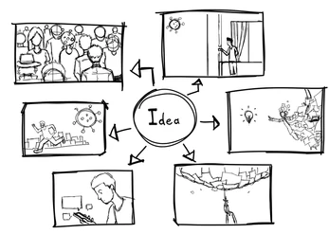



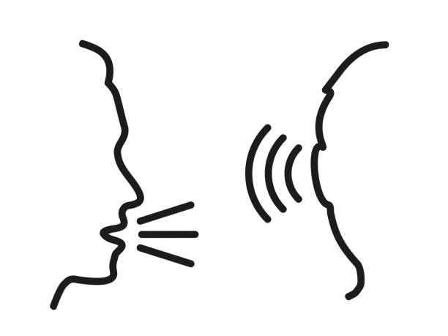

Slide 5
Don’t wait: write

Slide 6
Writing papers: model 1
Your idea
Do research
Write paper

Slide 7
Writing papers: model 2
Your idea
Do research
Write paper
Your idea
Write paper
Do research

Slide 8
Your idea
Write paper
Do research
Writing papers: model 2
Forces us to be clear, focused
Crystallises what we don’t understand
Opens the way to dialogue with others: reality check, critique, and collaboration

Slide 9
Writing papers: model 2
Your idea
Write paper
Do research
Your idea
Writing papers is a primary mechanism for doing research (not just for reporting it)

Slide 10
Identify your key idea

Slide 11
Your goal: to convey a useful and re-usable idea
You want to infect the mind of your reader with your idea, like a virus
The greatest ideas are (literally) worthless if you keep them to yourself

Slide 12
Do not be intimidated
Fallacy You need to have a fantastic idea before you can write a paper. (Everyone else seems to.)
Write a paper, and give a talk, about any idea, no matter how weedy and insignificant it may seem to you

Slide 13
Do not be intimidated
Writing the paper is how you develop the idea in the first place
It usually turns out to be more interesting and challenging that it seemed at first
Write a paper, and give a talk, about any idea, no matter how weedy and insignificant it may seem to you

Slide 14
The idea
Your paper should have just one “ping”: one clear, sharp idea
You may not know exactly what the ping is when you start writing; but you must know when you finish
If you have lots of ideas, write lots of papers
Idea:
A re-usable insight,
useful to the reader

Slide 15
Can you hear the “ping”?
Many papers contain good ideas, but do not distil what they are.
Make certain that the reader is in no doubt what the idea is. Be 100% explicit:
“The main idea of this paper is....”
“In this section we present the main contributions of the paper.”

Slide 16
Tell a Story

Slide 17
Your narrative flow
Imagine you are explaining at a whiteboard
Here is a problem
It’s an interesting problem
It’s an unsolved problem
Here is my idea
My idea works (details, data)
Here’s how my idea compares to other people’s approaches

Slide 18
Title (1000 readers)
Abstract (4 sentences, 100 readers)
Introduction (1 page, 100 readers)
The problem (1 page, 10 readers)
My idea (2 pages, 10 readers)
The details (5 pages, 3 readers)
Related work (1-2 pages, 10 readers)
Conclusions and further work (0.5 pages)
Structure (conference paper)
Contrast with the IMRaD format….

Slide 19
Nail your contributions to the mast

Slide 20
The introduction (1 page)
Describe the problem
State your contributions
...and that is all
ONE PAGE!
RECALL
5Qs
(CS)
What is the problem
Why is it interesting and important?
Why is it hard?
Why hasn't it been solved before?
What are the key components of my approach and results?

Slide 21
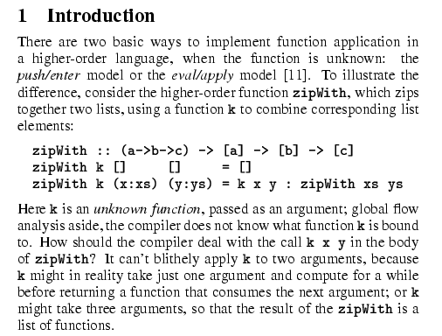
Describe the problem
Use an example to introduce the problem

Slide 22
State your contributions
Write the list of contributions first
The list of contributions drives the entire paper: the paper substantiates the claims you have made
Reader thinks “gosh, if they can really deliver this, that’s be exciting; I’d better read on”

Slide 23
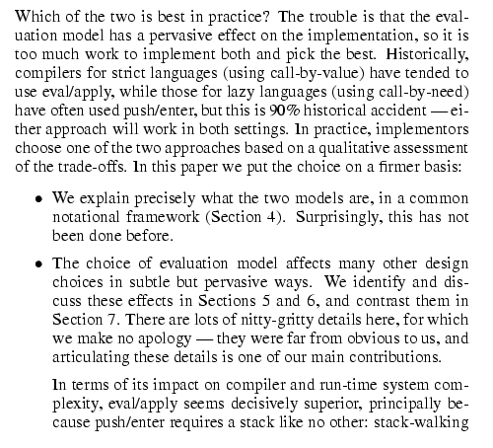
State your contributions
Do not leave the reader to guess what your contributions are!
Bulleted list of contributions

Slide 24
No!
Yes!
Contributions should be refutable
We describe the WizWoz system. It is really cool.
We give the syntax and semantics of a language that supports concurrent processes (Section 3). Its innovative features are...
We prove that the type system is sound, and that type checking is decidable (Section 4)
We have built a GUI toolkit in WizWoz, and used it to implement a text editor (Section 5). The result is half the length of the Java version.
We study its properties
We have used WizWoz in practice

Slide 25

Evidence
Your introduction makes claims
The body of the paper provides evidence to support each claim
Check each claim in the introduction, identify the evidence, and forward-reference it from the claim
“Evidence” can be: analysis and comparison, theorems, measurements, case studies

Slide 26
No “rest of this paper is...”
Not: “The rest of this paper is structured as follows. Section 2 introduces the problem. Section 3 ...Finally, Section 8 concludes”.
Instead, use forward references from the narrative in the introduction. The introduction (including the contributions) should survey the whole paper, and therefore forward reference every important part.

Slide 27

Related work: later

Slide 28
Structure
Abstract (4 sentences)
Introduction (1 page)
Related work
The problem (1 page)
My idea (2 pages)
The details (5 pages)
Conclusions and further work (0.5 pages)
NO!

Slide 29
Structure
Abstract (4 sentences)
Introduction (1 page)
The problem (1 page)
My idea (2 pages)
The details (5 pages)
Related work (1-2 pages)
Conclusions and further work (0.5 pages)
YES!

Slide 30
No related work yet!
Related work
Your reader
Your idea
We adopt the notion of transaction from Brown [1], as modified for distributed systems by White [2], using the four-phase interpolation algorithm of Green [3]. Our work differs from White in our advanced revocation protocol, which deals with the case of priority inversion as described by Yellow [4].

Slide 31
No related work yet!
Problem 1: the reader knows nothing about the problem yet; so your (highly compressed) description of various technical tradeoffs is absolutely incomprehensible
Problem 2: describing alternative approaches gets between the reader and your idea
z
z
z

Slide 32
Credit
Fallacy To make my work look good, I have to make other people’s work look bad.

Slide 33
The truth: credit is not like money
Warmly acknowledge people who have helped you
Be generous to the competition.
Acknowledge weaknesses in your approach
“In his inspiring paper [Foo98] Foogle shows.... We develop his foundation in the following ways...”
Giving credit to others does not diminish the credit you get from your paper

Slide 34
Put your readers first

Slide 35
Structure
Abstract (4 sentences)
Introduction (1 page)
The problem (1 page)
My idea (2 pages)
The details (5 pages)
Related work (1-2 pages)
Conclusions and further work (0.5 pages)

Slide 36
Structure
_{3. The idea}
Consider a bifircuated semi-lattice D, over a hyper-modulated signature S. Suppose pi is an element of D. Then we know for every such pi there is an epi-modulus j, such that p < p .
j
i
Sounds impressive...but
Sends readers to sleep, and/or makes them feel stupid

Slide 37
Presenting the idea
Explain it as if you were speaking to someone using a whiteboard
Conveying the intuition is primary, not secondary
Once your reader has the intuition, she can follow the details (but not vice versa)
Even if she skips the details, she still takes away something valuable

Slide 38
Conveying the intuition
Introduce the problem, and your idea, using EXAMPLES and only then present the general case
Remember: explain it as if you were speaking to someone using a whiteboard

Slide 39
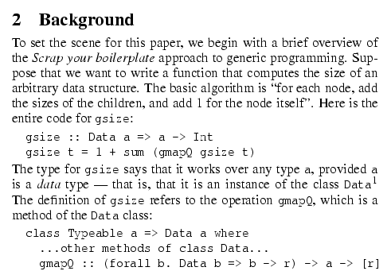
Using examples
Example right away
The Simon PJ question: is there any typewriter font?

Slide 40
Putting the reader first
Do not recapitulate your personal journey of discovery. This route may be soaked with your blood, but that is not interesting to the reader.
Instead, choose the most direct route to the idea.

Slide 41
Listen to your readers

Slide 42
Getting help
Experts are good
Non-experts are also very good
Each reader can only read your paper for the first time once! So use them carefully
Explain carefully what you want (“I got lost here” is much more important than “Jarva is mis-spelt”.)
Get your paper read by as many friendly guinea pigs as possible

Slide 43
Getting expert help
A good plan: when you think you are done, send the draft to the competition saying “could you help me ensure that I describe your work fairly?”.
Often they will respond with helpful critique (they are interested in the area)
They are likely to be your referees anyway, so getting their comments or criticism up front is Jolly Good.

Slide 44
Listening to your reviewers
Treat every review like gold dust
Be (truly) grateful for criticism as well as praise
This is really, really, really hard
But it’s really, really, really, really, really, really, really, really, really, really important

Slide 45
Listening to your reviewers
Read every criticism as a positive suggestion for something you could explain more clearly
DO NOT respond “you stupid person, I meant X”.
INSTEAD: fix the paper so that X is apparent even to the stupidest reader.
Thank them warmly. They have given up their time for you.

Slide 46

1. Don’t wait: write
3. Tell a story
4. Nail your contributions
5. Related work: later
6. Put your readers first (examples)
7. Listen to your readers
2. Identify your key idea
Seven simple, actionable suggestions

Slide 47
Section 3: Language and Style
(not comprehensive)

Slide 48
Basic stuff
Submit by the deadline
Keep to the length restrictions
Do not narrow the margins
Do not use 6pt font
On occasion, supply supporting evidence (e.g. experimental data, or a written-out proof) in an appendix
Always use a spell checker

Slide 49
Visual structure
Give strong visual structure to your paper using
sections and sub-sections
bullets
italics
laid-out code
Find out how to draw pictures, and use them

Slide 50
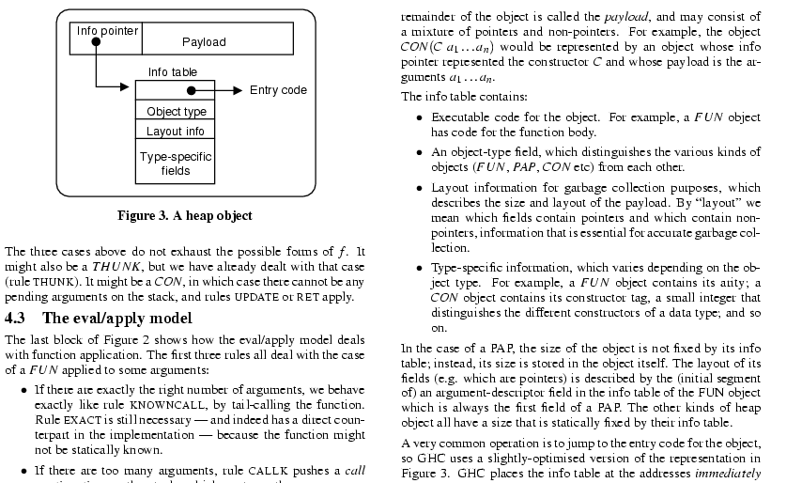
Visual structure

Slide 51
Use the active voice
No!
Yes!
It can be seen that...
34 tests were run
These properties were thought desirable
It might be thought that this would be a type error
We can see that...
We ran 34 tests
We wanted to retain these properties
You might think this would be a type error
The passive voice is “respectable” but it deadens your paper. Avoid it at all costs.

Slide 52
No!
Yes!
Use simple, direct language
The object under study was displaced horizontally
On an annual basis
Endeavour to ascertain
It could be considered that the speed of storage reclamation left something to be desired
The ball moved sideways
Yearly
Find out
The garbage collector was really slow

Slide 53


